Slide 1

Do not Forget Hardware Prefetching While Designing Secure Cache System MS Bi-annual Progress Seminar Sumon Nath | sumon@cse.iitb.ac.in Advised by Prof. Biswabandan Panda

Slide 2
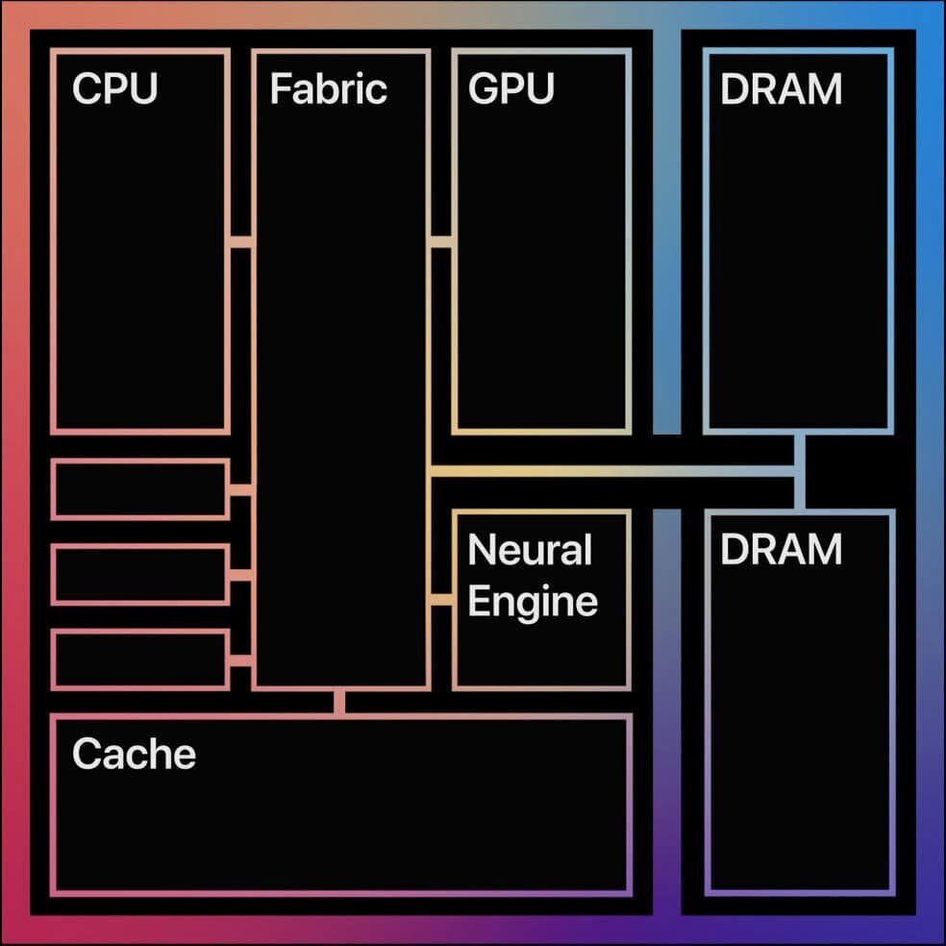
Recap: Speculative execution attacks
Apple M1
Out-of-order execution
Branch prediction
Wrong path execution
Secret data into cache
Attacker access secret data across context switches
Secret
https://www.apple.com/in/newsroom/2020/11/apple-unleashes-m1/

Slide 3

Threat Model
L1D Cache
int x = arr[0] // 2
int y = arr[1] // 21
if (x > y)
{ swap(x, y)
y++
z = arr[x % y] }
FALSE
Wrong prediction
TRUE
Squash Instr.s
print(x + y)
Data still present in cache

Slide 4
Secure Cache system: GhostMinion^{[MICRO ‘21]}
CPU
L1D
GM
Filter cache
Stores all speculative data
Wiped on context switch
L2
LLC
DRAM

Slide 5
Secure Cache system: GhostMinion^{[MICRO ‘21]}
CPU
L1D
GM
L2
LLC
DRAM

Slide 6
Secure Cache system: GhostMinion^{[MICRO ‘21]}
Speculative path
CPU
Commit Write – hit in GM
Commit Load – miss in GM
Re-fetch
L1D
GM
Writeback
Cache state untouched
LRU bits not updated on hit
Bypass fills to L1/L2/LLC
L2
LLC
Caches updated On-commit
Writeback to L1-> L2 -> LLC
Re-fetch to L1
DRAM

Slide 7
What about prefetching?
Train
CPU
Non-Speculative
Speculative
Prefetcher
L1D
GM
Train & Trigger
On-access
On-commit
Trigger
L2
Speculative prefetching
LLC
DRAM

Slide 8
Prefetcher of interest: Berti^{[MICRO ‘22]}
Delta: Diff. b/w two cache lines
Local: Per Instruction Pointer
Timely: Prefetched before demand access
Accurate and timely local delta L1D prefetcher
.
.
.
.
.
.
@2
@5
@7
@10
@12
@15
Timeline
Goal: find a delta that can trigger a timely prefetch for @15
deltas: +8, +5, +3

Slide 9
Berti^{[MICRO ‘22]} prefetcher
Delta: Diff. b/w two cache lines
Local: Per Instruction Pointer
Timely: Prefetched before demand access
Accurate and timely local delta L1D prefetcher
.
.
.
.
.
.
@2
@5
@7
@10
@12
@15
Timeline
Crux:
Capture the repeating pattern of deltas per IP
To Trigger Timely prefetches
Deltas
+13
+10
Increase confidence
Time to fetch @15 (latency)
Timely deltas: +13, +10

Slide 10
Terminology
Non-secure cache system | Conventional
Cache system
Secure cache system | GhostMinion
On-access | Unsafe
Prefetching
On-commit | Safe

Slide 11
Impact of secure cache system & on-commit prefetching
31%
23%
21%
Overall ~11 % degradation from on-access(non-secure) to on-commit (secure)

Slide 12
Problems & contributions
Negative impact of secure cache system on prefetching
Secure update filter
Timeliness issues with
secure prefetching
Timely secure prefetcher

Slide 13
Problem 1: Impact of secure cache system
Average Traffic increases from 199 to 375 accesses per kilo instruction (APKI)

Slide 14
Increase in miss latency
L1D load miss latency increases from 83 to 117 cycles

Slide 15
Increased Pressure on L1D
L1D
Demand Requests
Commit Requests
Prefetch Requests

Slide 16
Redundant requests to cache system
Speculative path
CPU
Commit Write
Commit Load
Re-fetch
L1D
GM
Writeback
More than 95% redundant commit requests to L1D
L2
LLC
DRAM

Slide 17
Enhancement 1: Secure update filter(SUF)
LQ
Speculative Path
…
Commit Path
❶
Hit-level (HL, 2 bit)
L2 writeback bit
Hit level: cache level that served the request
Writeback bit (wbb)
❷
GM
HL!=00
Y
L1D
Improves performance by 3.3% across prefetchers
N
DROP
❸
L2
Y
Filtering accuracy > 98%
❹
wbb?
Y
wbb
Storage overhead 0.12 KB
wbb?
N
LLC
DROP
N
DROP

Slide 18
Problem 2: Issues with Secure Prefetcher
Berti relies on fetch latency
Latency seen by prefetcher is mis-leading (Timeliness)
Trigger events should be relative to on-commit events

Slide 19
Timely prefetch if prefetcher trained on-access
On-commit prefetching Timeliness
Timely prefetch if prefetcher trained on-access
Not prefetched on-commit
Prefetched late on-commit
L2
Commit Late prefetches increases overall MPKI

Slide 20
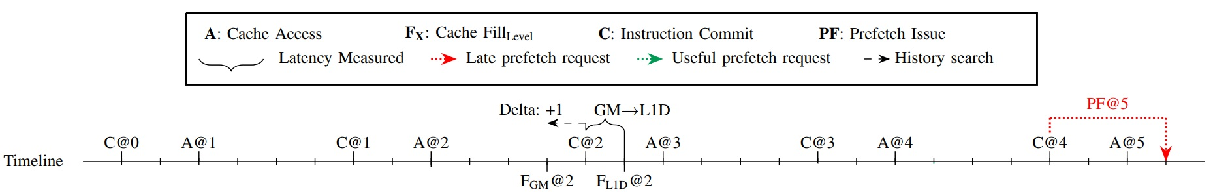
On-commit Berti: Measured latency problem
Notes:
Two separate timelines for on-commit berti and timely secure berti
Title Problem with latencies, then transform problem with solution , TSB. Maybe another slide with TSB(will also have the first timeline)

Slide 21
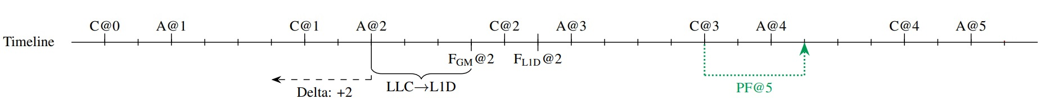
On-commit Berti: Measured latency problem
Enhancement 2: Timely Secure Berti (TSB)

Slide 22
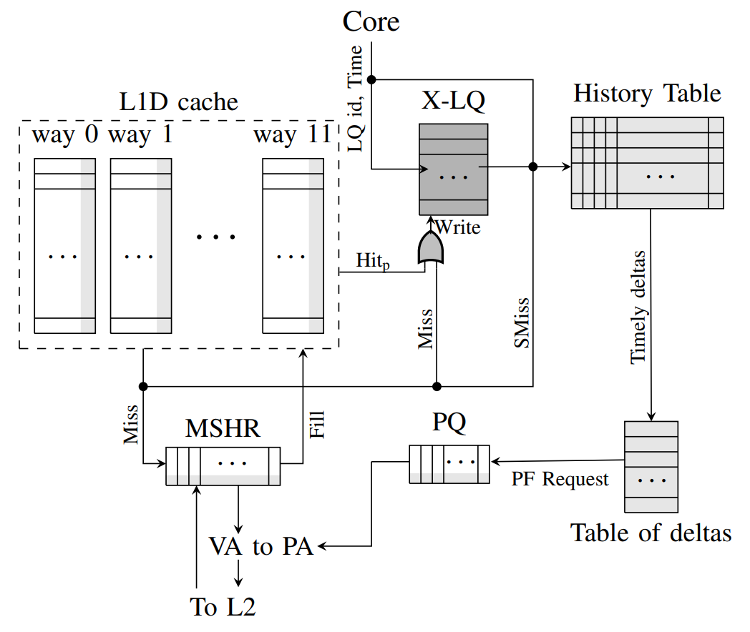
TSB: Hardware implementation
Storage overhead 0.47 KB
Notes:
First show Berti, then show TSB additions

Slide 23
Evaluation setup
Champsim(Intel Sunny Cove)
Normalized to non-secure cache system without prefetching
SPEC CPU 2017 & GAP benchmarks

Slide 24
Performance improvement
3%
31%
23%
28%
21%
TSB improves performance by 6.3 % compared to On-commit Berti

Slide 25
Power reduction
30%
42%
SUF reduces dynamic energy consumption by 9.1%

Slide 26
Multi-core performance
TSB+SUF improves performance by 16.1% over baseline

Slide 27
Summary
Secure cache systems hinders prefetcher performance
Prefetchers are not built for on-commit training/trigger
SUF , TSB improves prefetcher performance with security guarantees

Slide 28
Thanks and fingers crossed!
Collaboration with Prof. Alberto Ros and Agustin, University of Murcia
Work under submission to ISCA 2024, flagship forum in the field of computer architecture

Slide 29
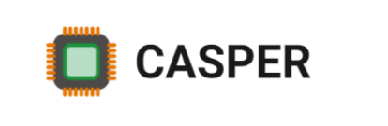
Thank You

Slide 30

Background: Spectre^{[S&P ‘19]}(variant 1)
cached
uncached
if ( x < array1_size )
y = array2[ array1[ x ] * 512 ]
11 E2 45 CD
array2 [ 0 * 512 ]
array2 [ 1 * 512 ]
array2 [ 2 * 512 ]
array2 [ 3 * 512 ]
array2 [ 4 * 512 ]
array2 [ 5 * 512 ]
array2 [ 6 * 512 ]
array2 [ 7 * 512 ]
array2 [ 8 * 512 ]
array2 [ 9 * 512 ]
array2 [ 10 * 512 ]
array2 [ 11 * 512 ]
array2 [ 12 * 512 ]
x , adversary controlled
Adversary wants to read some out of bounds value of array1
array1_size and array2[ ] not in cache
Mistrains branch predictor
Notes:
Simple explanation of the code
Scenario: what the adversary wants
State of other microarchitecture structure

Slide 31
Background: Spectre^{[S&P ‘19]} (variant 1)
cached
uncached
if ( x < array1_size )
y = array2[ array1[ x ] * 512 ]
Secret
11
11 E2 45 CD
array2 [ 0 * 512 ]
array2 [ 1 * 512 ]
array2 [ 2 * 512 ]
array2 [ 3 * 512 ]
array2 [ 4 * 512 ]
array2 [ 5 * 512 ]
array2 [ 6 * 512 ]
array2 [ 7 * 512 ]
array2 [ 8 * 512 ]
array2 [ 9 * 512 ]
array2 [ 10 * 512 ]
array2 [ 11 * 512 ]
array2 [ 12 * 512 ]
Attacker calls victim with out-of-bounds x
Wrongly predicts true and starts Speculative exec
Reads addr (array1 base + x) with out-of-bounds x
Read returns Secret byte = 11
Brings array2 [11 * 512] into cache
Branch resolves: instructions squashed
Attacker times reads from array2[ i * 512 ]
Read for i = 11 is fast, revealing secret data
array2 [ 11 * 512 ]

